Slide 1
Capstone Project Analysis of Lending Club Data
Sathish Kumar V
Mentor: Neal Fultz

Slide 2
Introduction
Project Objective
Looking into the Data
Statistical Modeling
Summarize

Slide 3

Introduction
Lending Club is an online marketplace of borrowers and investors and aims to transform the banking system to make credit more affordable and investing more rewarding.

Slide 4

Project Objective
Unlike traditional lending via banks, peer-to-peer lending is conducted online and the onus is on the platform(lendingclub.com in this case) to provide a safe & trustworthy deal for the investors to put in their money.
This project aims to use the data released by lendingclub.com and predict the possibility of a loan going bad. This system will flag potentially risky loans for the platform to make an informed decision based on the historical empirical data.

Slide 5
Project Objective (contd)
For this project, we will use three datasets:
LoanStats3a.csv – Loan Statistics from 2007 – 2011 containing 42542 observations of 112 variables
LoanStats3b.csv - Loan Statistics from 2012 – 2013 containing 188128 observations of 112 variables
LoanStats3c.csv - Loan Statistics for 2014 containing 67502 observations of 112 variables
We will combine the datasets and build a training dataset from 2007 – 2013. On this dataset, we will build a logistic regression model and randomForest model. These models will be used to make predictions on the testing dataset (LoanData for 2014).

Slide 6
Looking at the Data
The dataset has 112 variables, of which, many are filled with NA values.
The loan_status column shows the current status of the loan and we will use this variable to flag loans which have a higher risk of default. The following status will be classified as bad loans
Charged Off
Late (31-120 days)
Late (16-30 days)
Default
By plotting the density graph using ggplot2, we have identified some of the variables that can be used to build the models

Slide 7
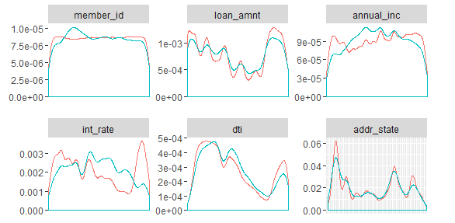
Looking at the Data
By plotting the density graph using ggplot2, we have identified some of the variables that can be used to build the models. Loans identified as risky are plotted in red, while safe loans are plotted in blue.

Slide 8
Logistic Regression Model
By iterating across various models, we have isolated the critical variables as the annual income, loan amount, interest rate & the grade
Using these variables, we built a logistic regression model and predicted the possibility of a default on the testing data set.
logmodel <- glm(bad_loan ~ loan_amnt + annual_inc + grade + int_rate, data = df, family = "binomial")

Slide 9
Logistic Regression Model
The following confidence matrix was obtained
Sensitivity = 12/43 = 0.28
Specificity = 59099/67459 = 0.87
 | 0 | 1
0 | 59099 | 8360
1 | 31 | 12

Slide 10
Random Forest Model
The default nodesize for the random forest model is 5.
Since the current training dataset has 230k observations, running the random forest throws up memory allocation error. Therefore, the nodesize is set to 6
X <- as.matrix(df$int_rate)
rfmodel <- randomForest(X,df$bad_loan, nodesize = 6)

Slide 11
Random Forest Model
With the random forest model, the following predictions are seen
Threshold | 0.1 |  | 0.2 |  | 0.3
 | 0 | 1 | 0 | 1 | 0 | 1
FALSE | 40034 | 7132 | 12424 | 2980 | 1422 | 411
TRUE | 19096 | 1240 | 46706 | 5392 | 57708 | 7961
Sensitivity | 0.06 |  | 0.1 |  | 0.12
Specificity | 0.85 |  | 0.81 |  | 0.78

Slide 12
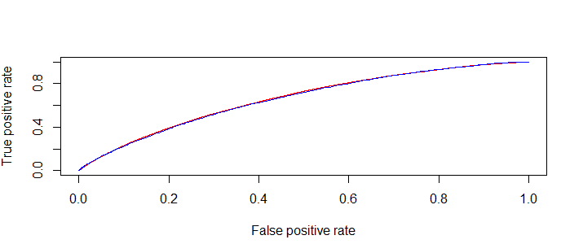
ROC & AUC
The ROC curve is plotted and the AUC is calculated to be ~0.5 for each of the models
The logistic regression model is plotted in red and the randomForest model is plotted in blue

Slide 13

Conclusion
For the peer-to-peer lending model to flourish, the system should be able to offer healthy loans to the investors and therefore, must build a robust system to offer higher returns and flag potentially risky loans. This solution can be deployed to check new loan applications and validate their credentials before putting forth the proposal before the investors.

Slide 14
Thank You !

